Slide 1
Exploring Flood Risk in Asheville, NC
Sara Diamond, Addie Navarro, and Natalie von Turkovich

Slide 2
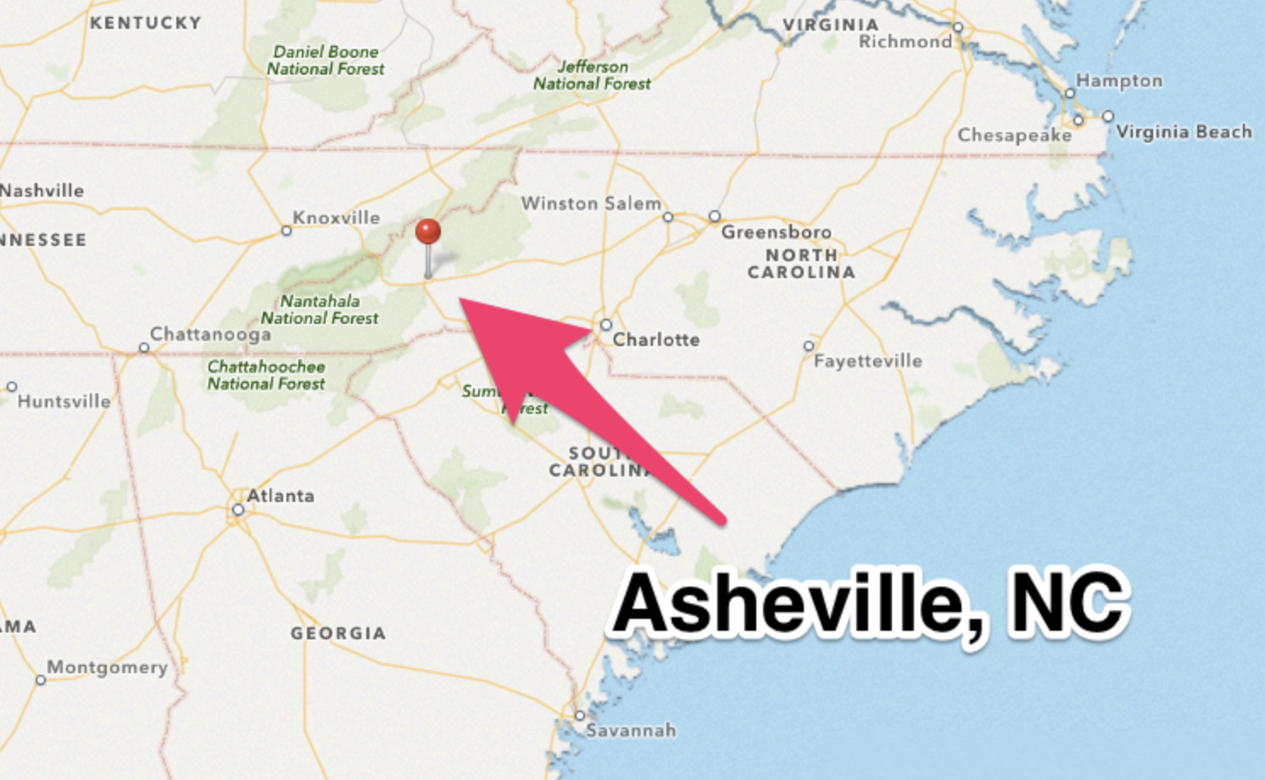
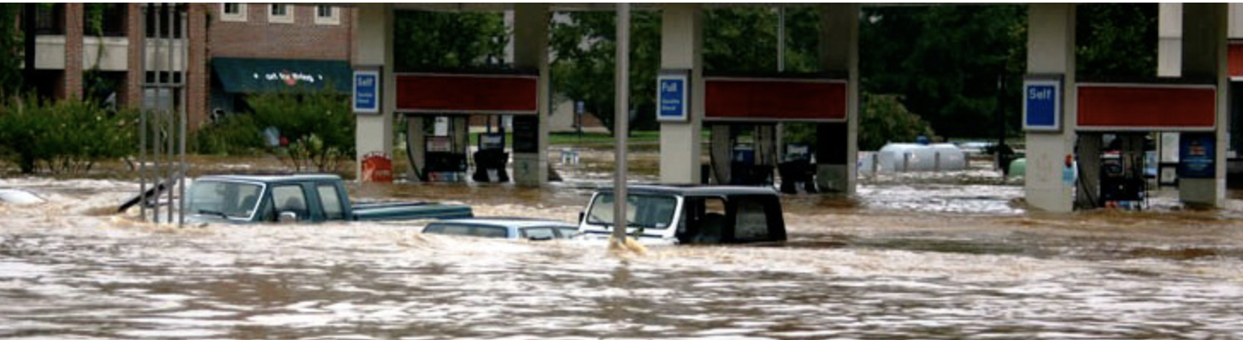
Background & Central Question
Increase in flooding events in recent years in Western North Carolina
Mountainous areas particularly sensitive to climate change/events
Increase of incised rivers and deforestation leading to increased flood risk in these regions
Has extreme precipitation increased over time and how has that impacted the flood risk in along the French Broad River in Asheville, North Carolina?

Slide 3


Processes Used to Wrangle Data
Stream Gauge Discharge:
Pulled data in from USGS using National Water Information System (NWIS) function
Filtered data for dates ranging from 1981-2021
Checked to get rid of any missing data
Used lubridate package to adjust the date column
Precipitation:
Downloaded csv file from NOAA Precipitation Frequency Estimate Database and NOAA Global Historical Climatology Network
Filtered data for dates ranging from 1981-2021
Deleted unnecessary columns
Added month and year column

Slide 4
Analysis of the Data
Stream Gauge Discharge:
Ran a timeseries analysis to understand the overall trend of discharge data over time
Used Seasonal Mann-Kenndall test from Kendall package and from the trend package
Ran GLM to understand the relationship between discharge and precipitation
Precipitation:
Made a table of significant rainfall events for a 24-hour period
Used 1-year, 2-year, and 5-year recurrence interval thresholds to plot occurrence and frequency of significant precipitation events

Slide 5
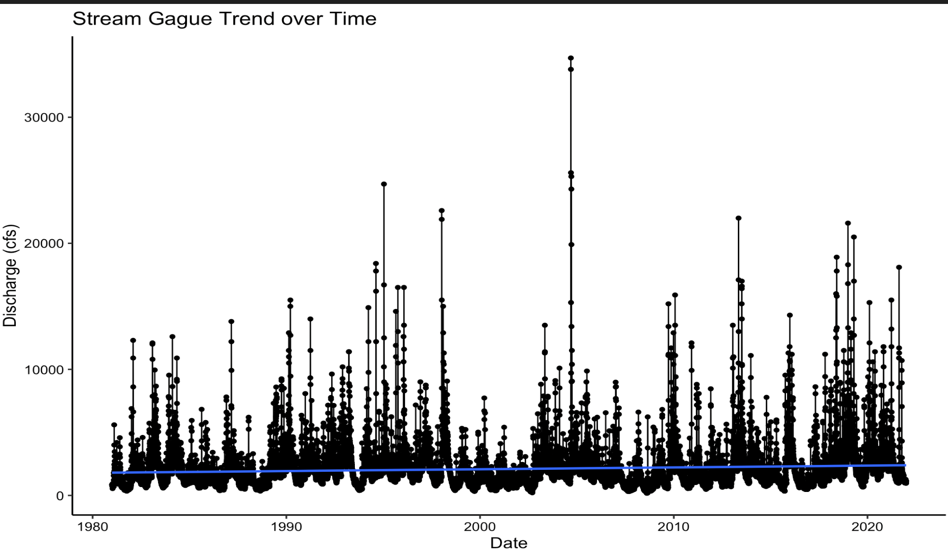
Results
Stream Gauge – Discharge:
Time Series:
Null Hypothesis: There is no trend in seasonal discharge data
Alternative Hypothesis: There is a trend in seasonal discharge data
Results showed Seasonal Mann-Kenndall Test was significant with a p-value < 0.05 and positive tau (but small)

Slide 6
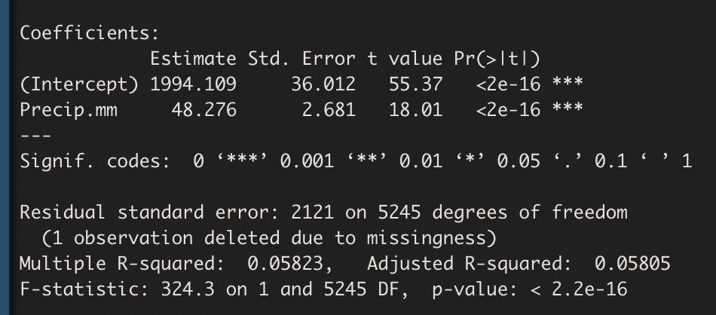
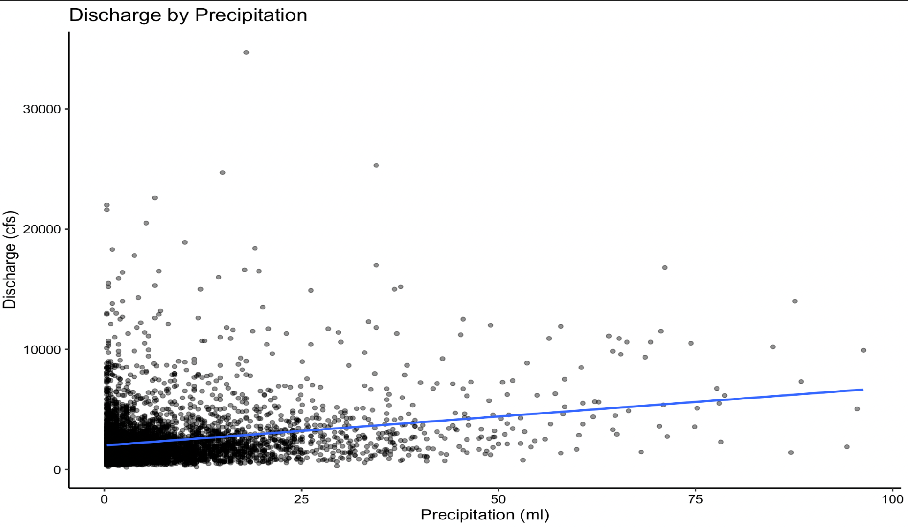
Results
GLM Model:
Significant relationship between Discharge and Precipitation
R^2 value does not explain a lot of the variation – something to look into more
For every 1 unit of precipitation discharge increases by ~ 48 cubic feet/second

Slide 7
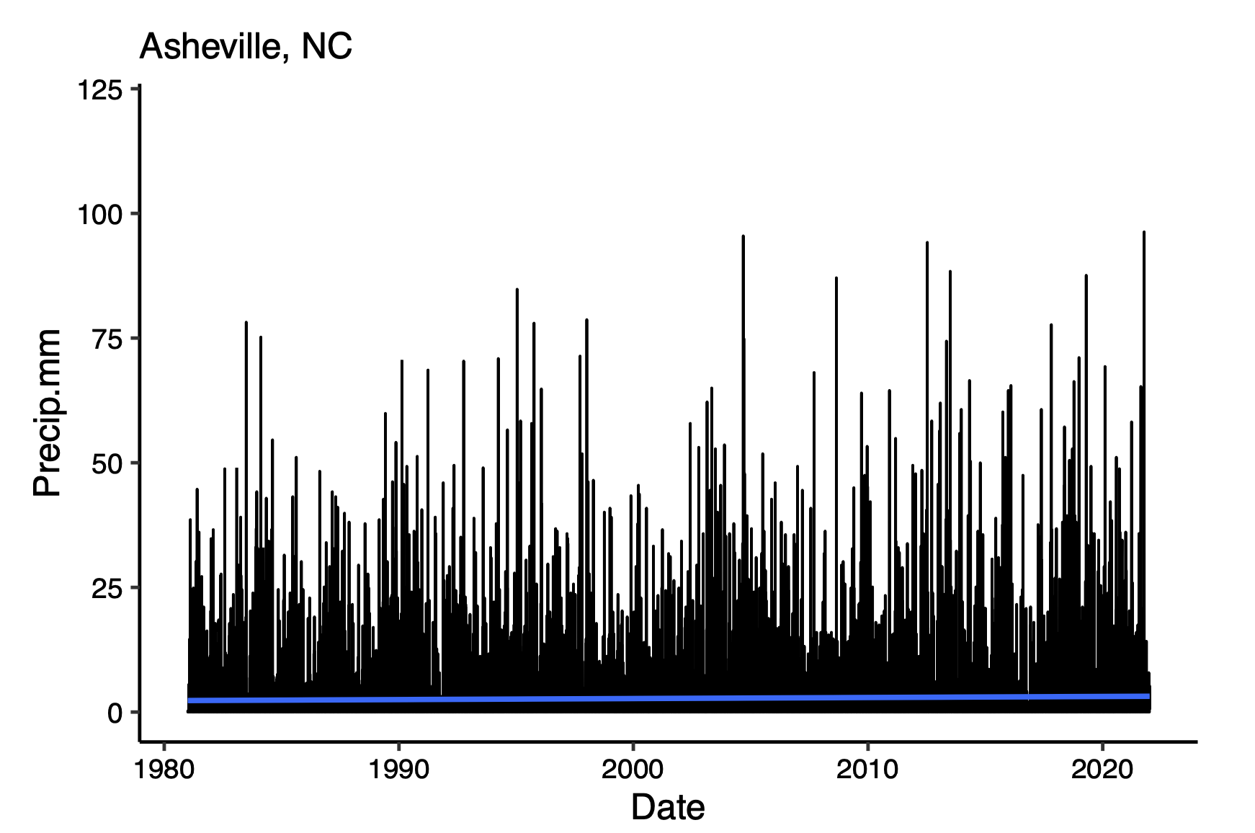
Results
Precipitation
Precipitation events above the 1-year, 2-year, and 5-year thresholds increased in frequency over time.
More extreme rainfall events occurred between 2001-2021 than 1981-2001
For example, the 5-year rainfall event has occurred 6 times between 2001-2021 and only once before 2000.
Asheville, NC Precipitation

Slide 8
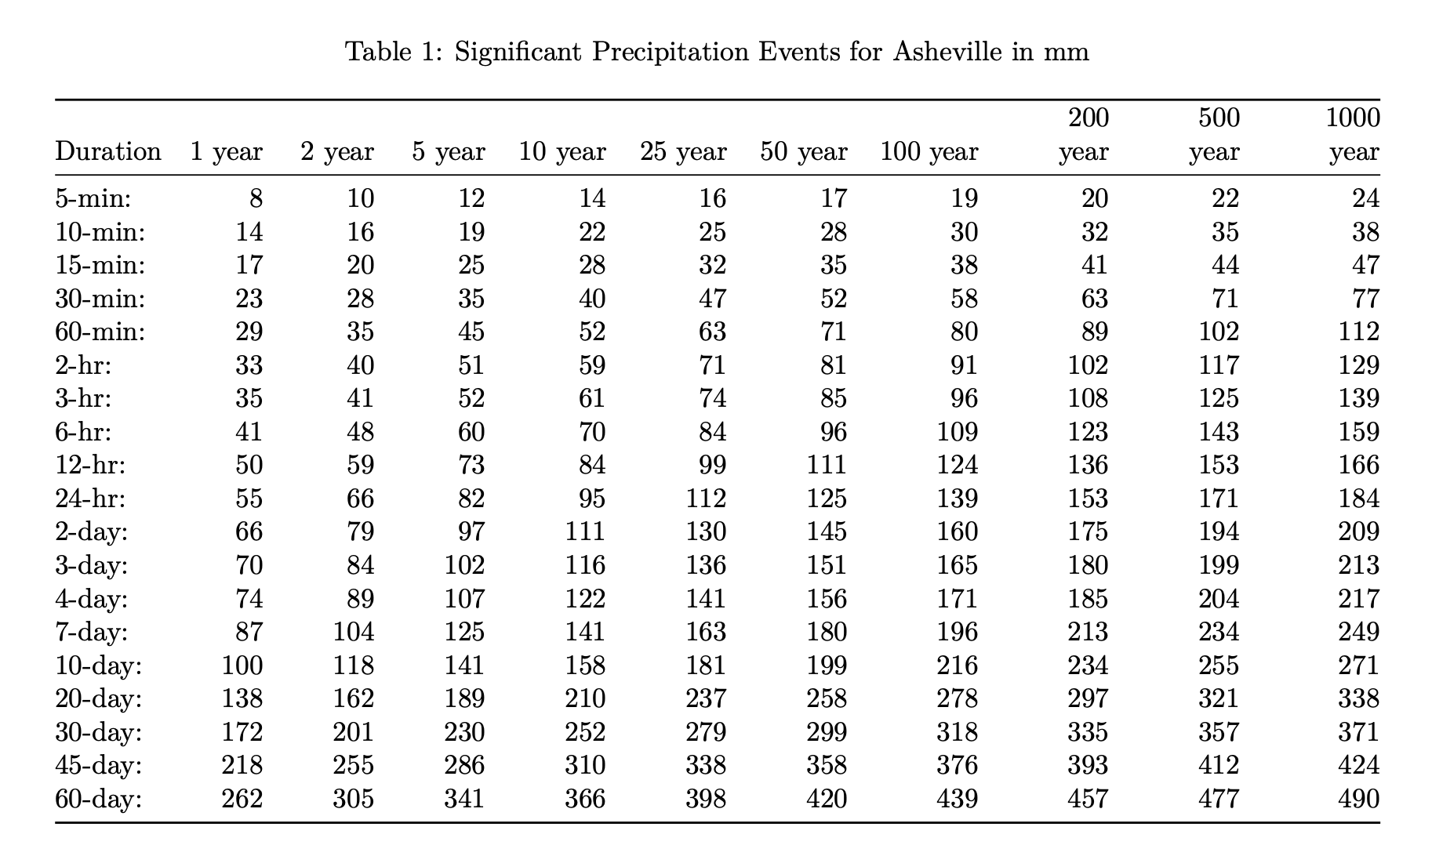
Results
Precipitation – Significant Events

Slide 9
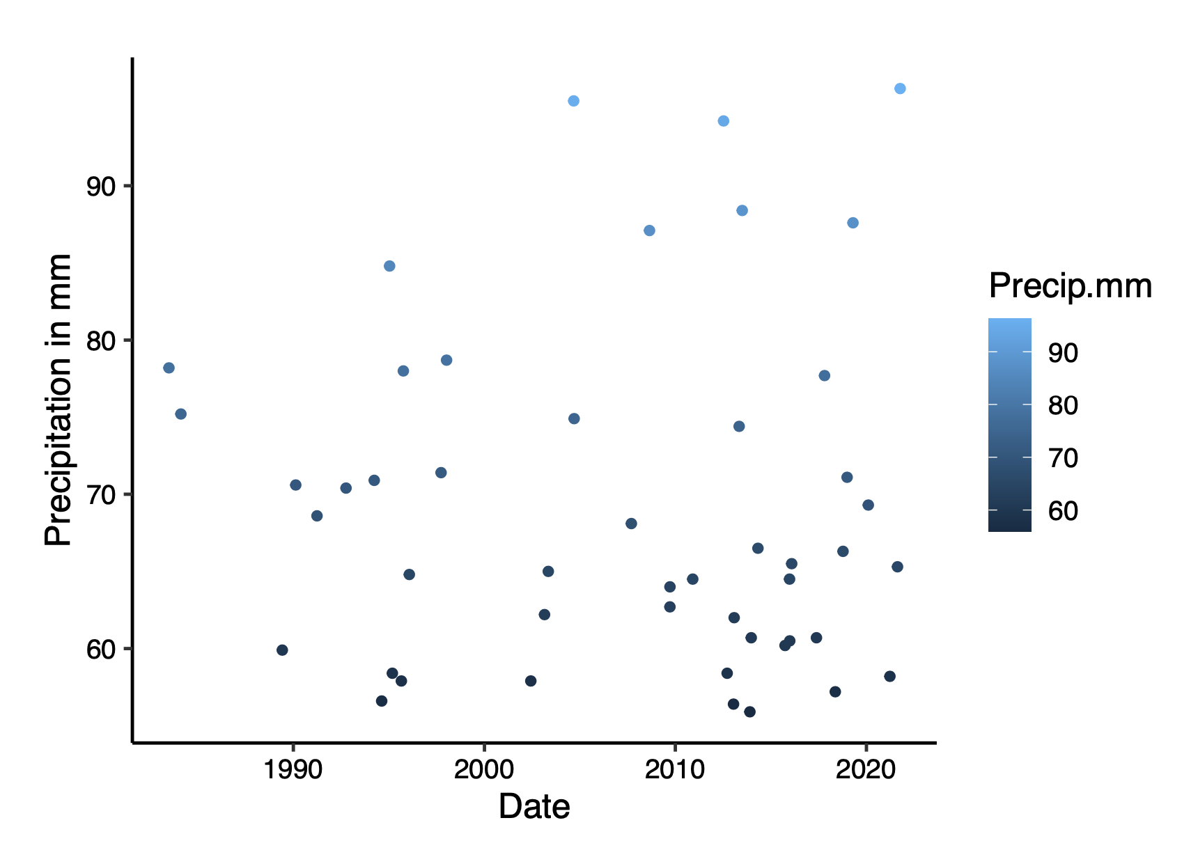
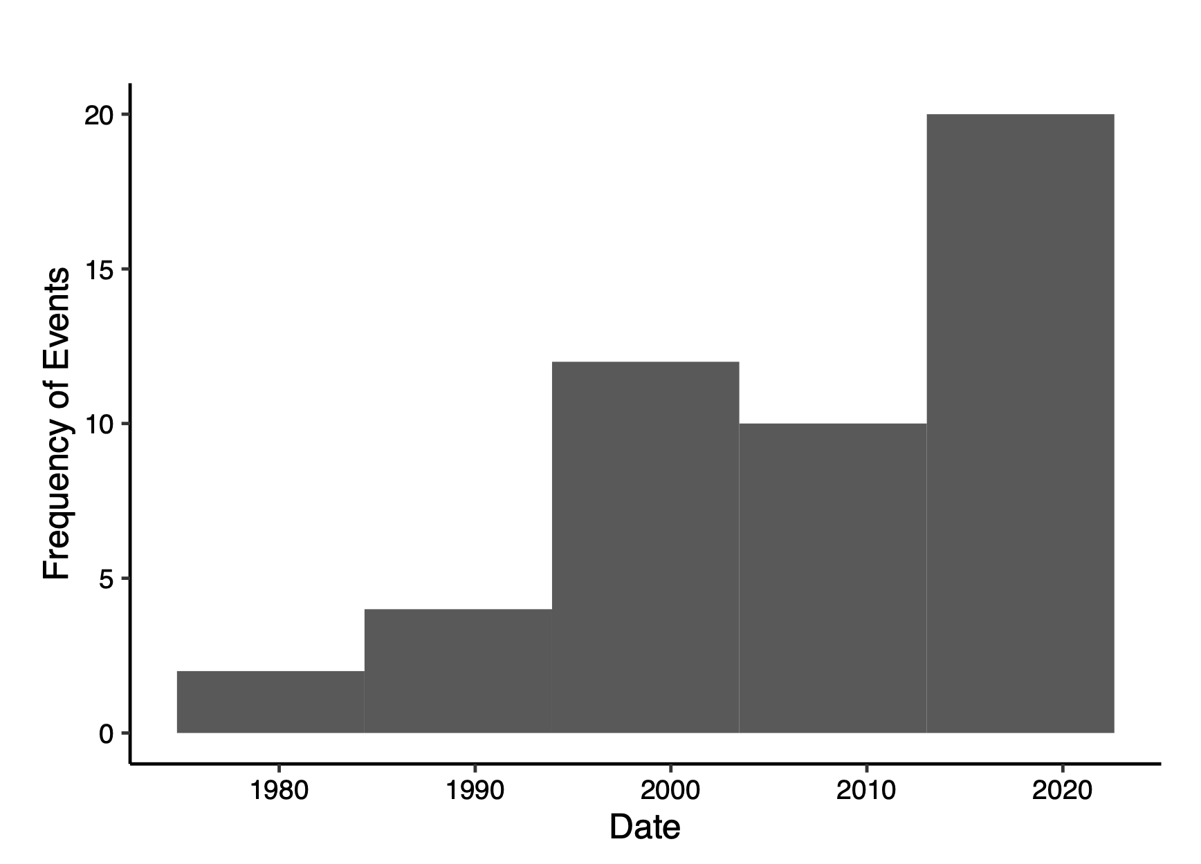
1 Year 24 hr Rain Event – 55 mm
Precipitation Events Over 1 Year Threshold
Number of Events Over 1 Year Threshold

Slide 10
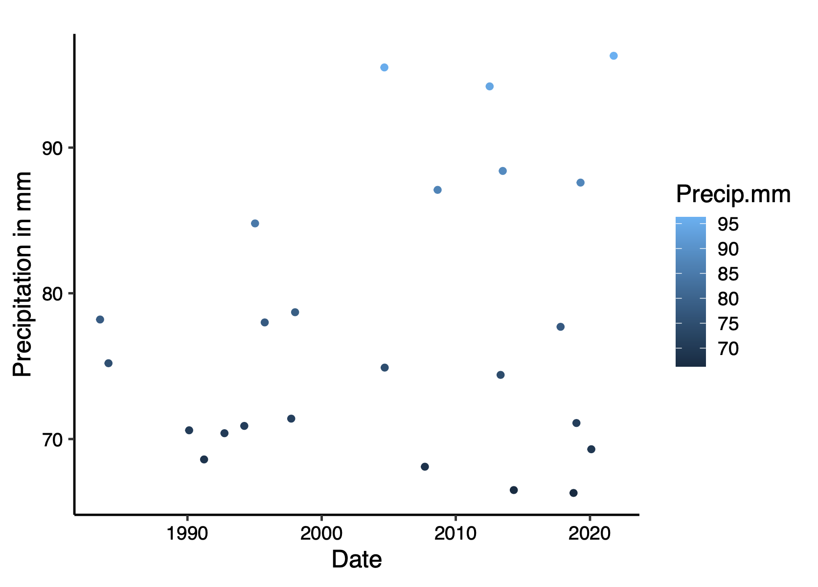
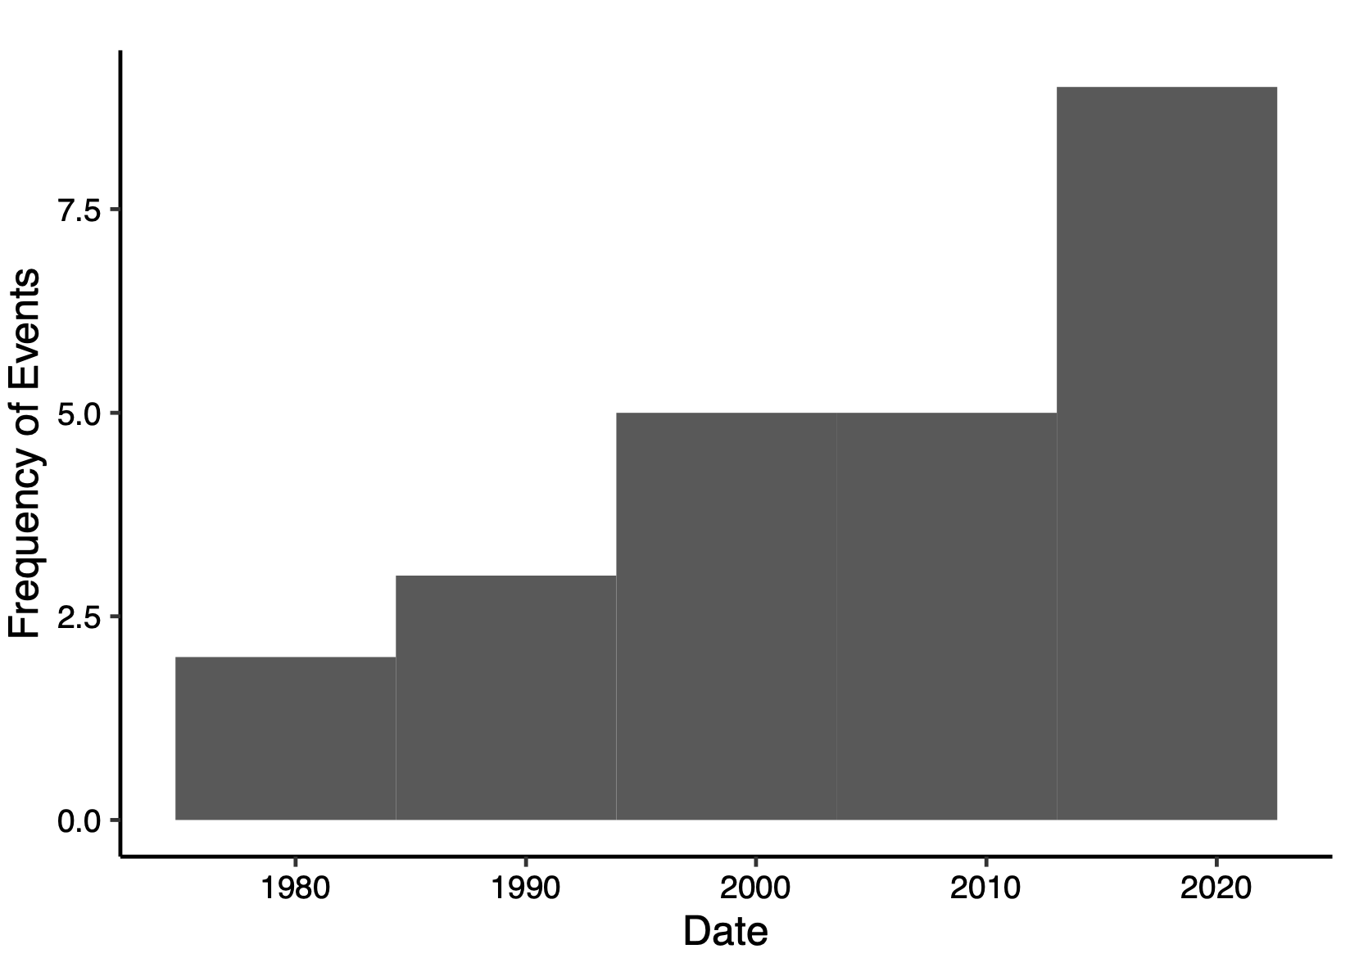
2 Year 24 hr Rain Event – 66 mm
Precipitation Events Over 2 Year Threshold
Number of Events Over 2 Year Threshold

Slide 11
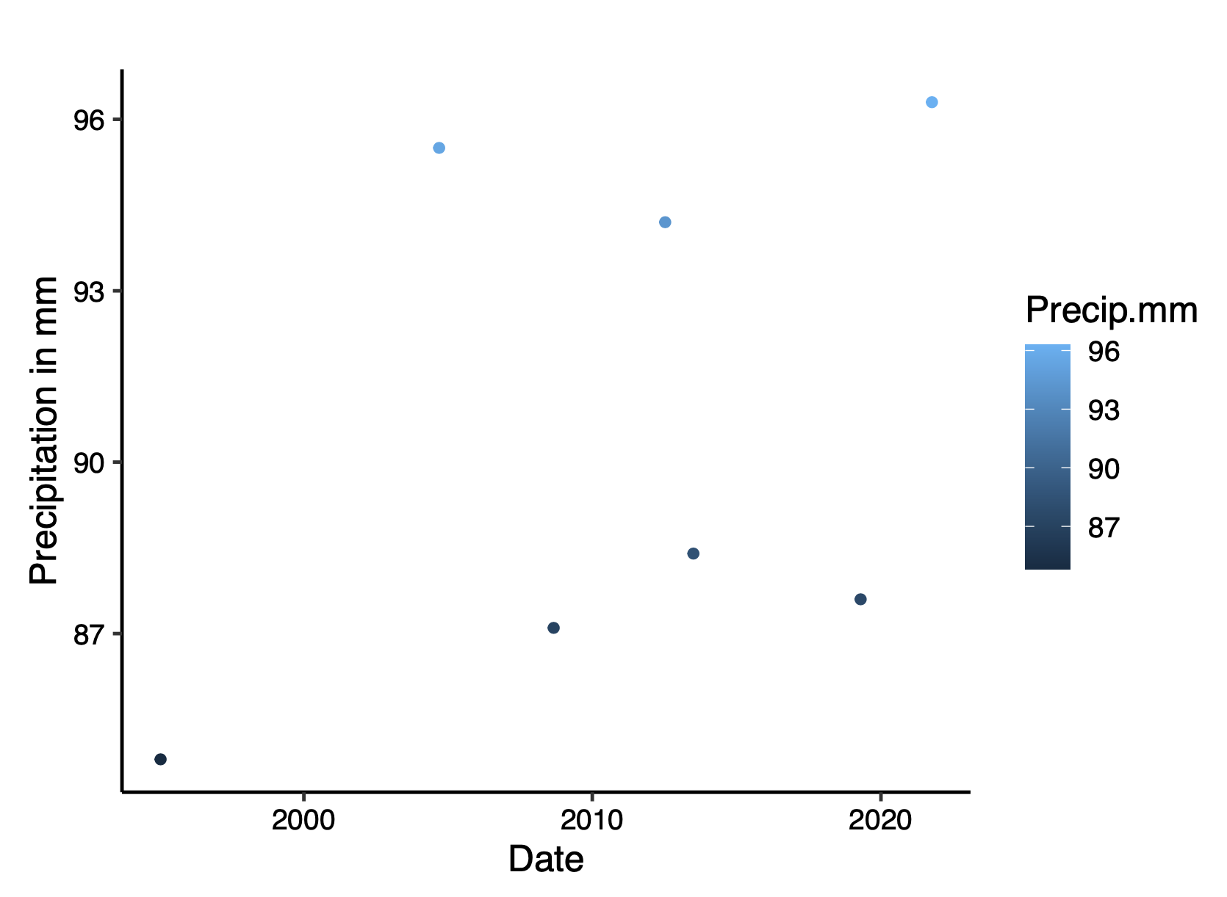
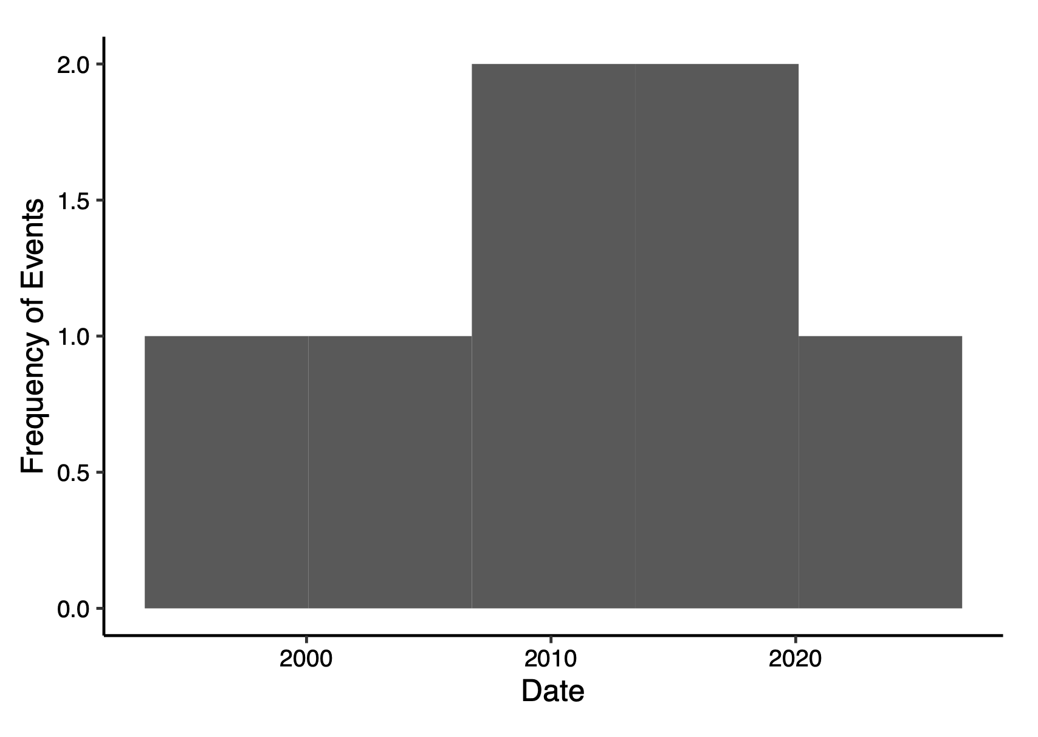
5 Year 24 hr Rain Event – 82 mm
Precipitation Events Over 5 Year Threshold
Number of Events Over 5 Year Threshold
*note all events are in year 2000 or later

Slide 12
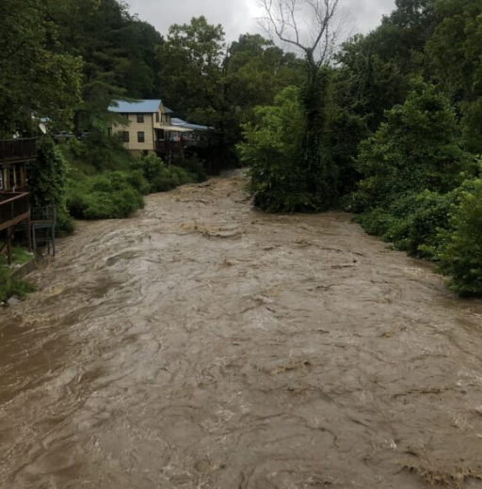
Summary
Precipitation is increasing overtime
Precipitation has a significant effect on river discharge
Extreme precipitation events are becoming more frequent over time and are increasing in intensity
Increasing risk of flooding in Asheville
How can the city of Asheville adapt to increasing risk?
Questions, comments?

